Slide 1
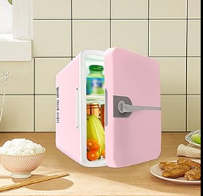
AI-Based Control & Optimization for Smart Freezer System
Intelligent monitoring, control, and optimization of freezer systems using real-time sensor data combined with machine learning. Focuses on early fault detection, adaptive control, and efficient operation.
Key message: This system transforms a traditional freezer into an intelligent, self-aware control system.

Slide 2
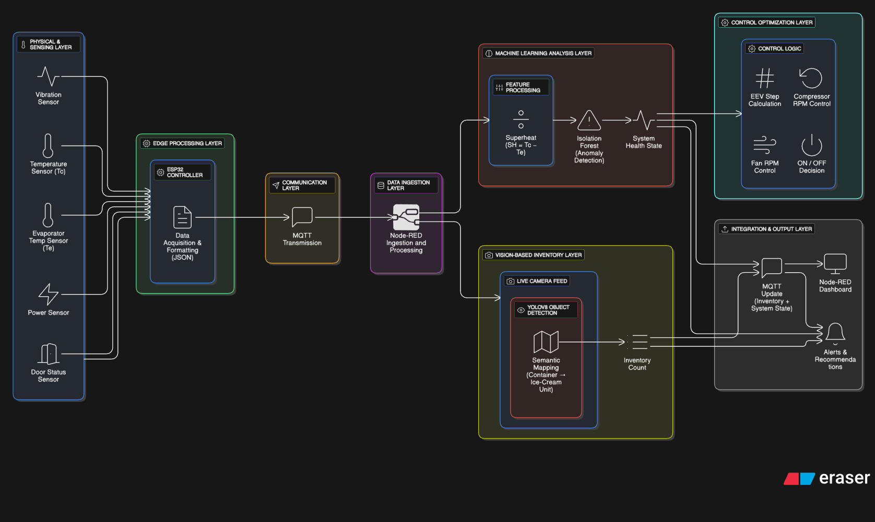

Slide 3
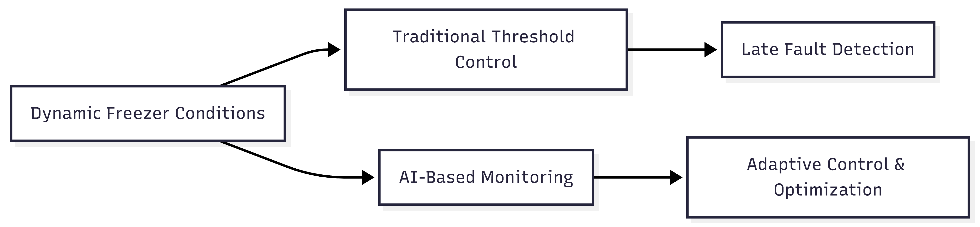
Why Control & Optimization Is Needed
Problem Context
Limitations of Traditional Control
Freezer operation is dynamic and non-linear:
Fixed thresholds
Temperature varies with load and door usage
Reactive fault handling
Compressor stress changes gradually
Energy inefficiency
Power conditions fluctuate
No understanding of system behavior
Usage patterns are unpredictable

Slide 4
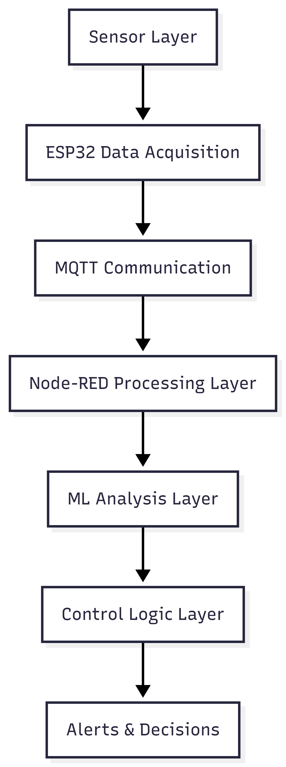





Overall Control & Data Architecture
Layered System Architecture
Data Acquisition Layer
Sensing physical parameters
Data Processing Layer
Aggregation and formatting
AI Analysis Layer
Behavior learning & anomaly detection
Control Logic Layer
Decision making
Alert & Action Layer
User interaction

Slide 5










Phase 1: Data Acquisition (Control Foundation)
Purpose
Provide accurate, continuous, real-time data
Form the foundation for AI-driven control
Temperature
Humidity
Why This Phase Is Critical
AI decisions depend entirely on data quality
Enables system awareness and responsiveness
Door Status
Vibration
Power Consumption

Slide 6
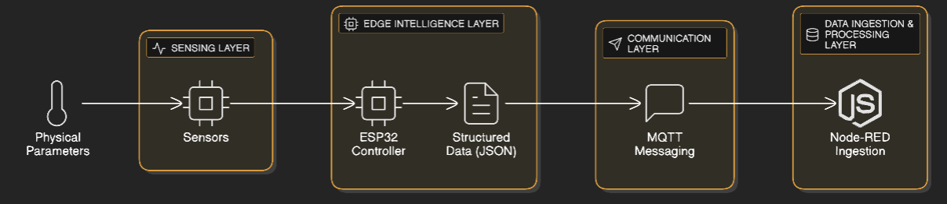

Slide 7



Phase 2: Machine Learning for Control
ML Model Used
Why This Model
Input Features
Isolation Forest (Unsupervised Learning)
No labeled fault data required
Temperature
Learns normal freezer behavior automatically
Vibration
Power
Detects deviations instead of threshold violations
Humidity

Slide 8
How Isolation Forest Works (Control View)
Control-Oriented Explanation
Control Advantage
01
Enables graded response
Normal behavior forms dense clusters
02
Supports early intervention
Abnormal behavior is isolated faster
03
Avoids binary on/off control
Output is a severity score, not just a flag

Slide 9




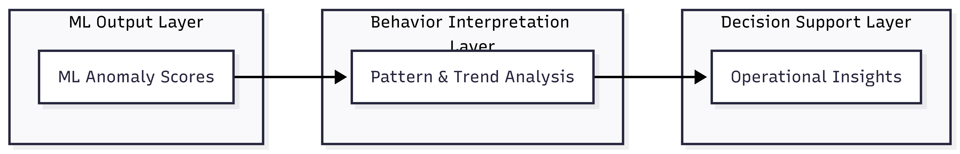
What We Found Using ML
Observed System Behaviors
Early Temperature Rise
Gradual Vibration Increase
Early temperature rise before threshold breach
Gradual vibration increase indicating compressor stress
Power Anomalies
Humidity Irregularities
Power anomalies indicating overload
Humidity irregularities linked to door usage

Slide 10
Phase 3: Control Optimization Overview
This phase moves from detection to decision-making
Machine learning outputs are combined with real-time system parameters. The goal is to convert data-driven intelligence into actionable control decisions. Ensures efficient, safe, and reliable freezer performance.
Optimized Components
Electronic Expansion Valve (EEV)
Compressor Speed
Position control
Control (RPM)
Condenser Fan Speed
Operational State
Control (RPM)
ON / OFF / Alert

Slide 11
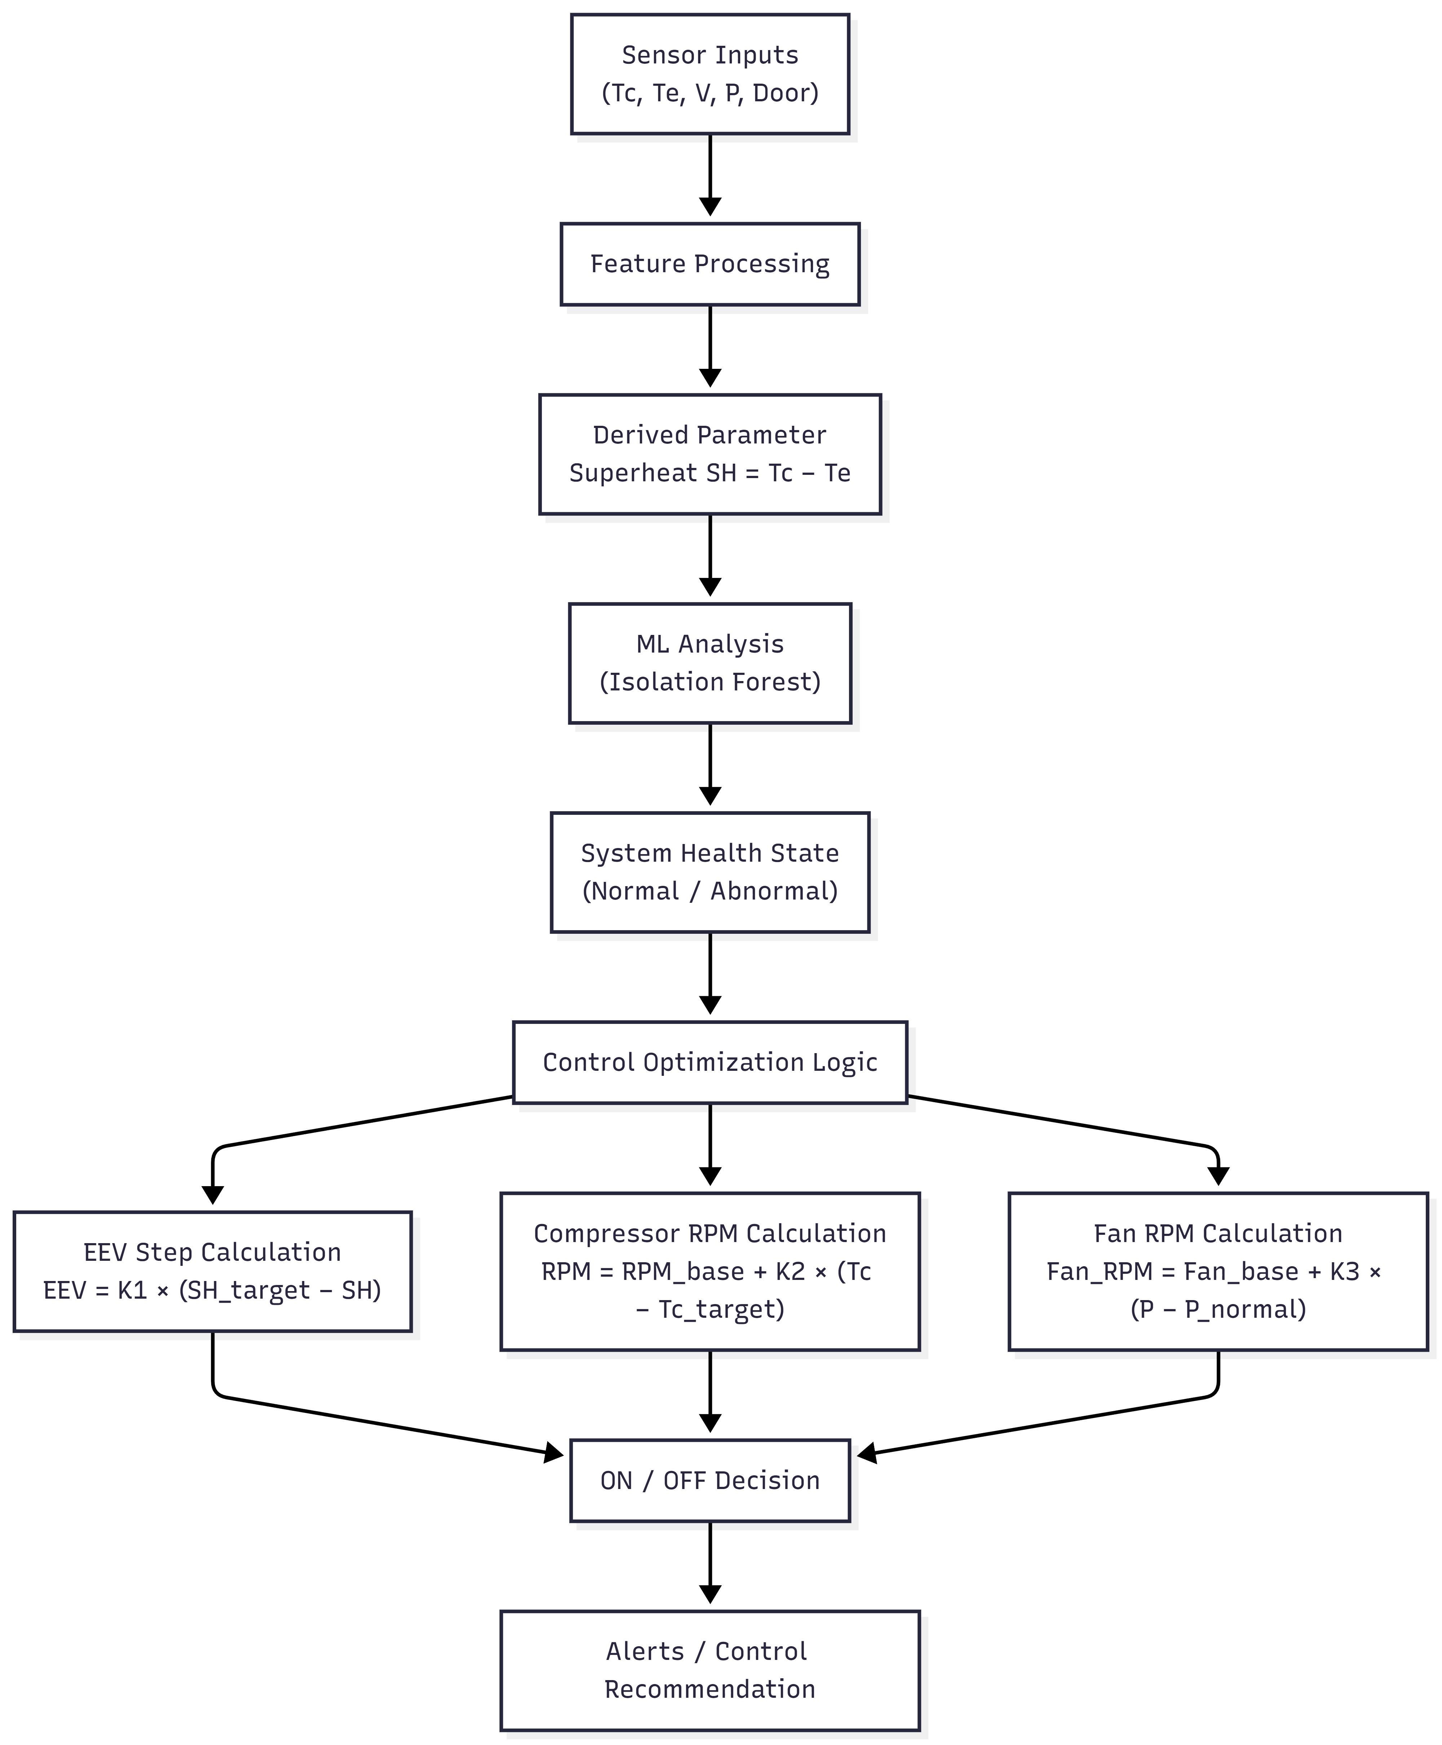
Control Optimization Flow – Explanation
Sensor data captures the real-time operating condition of the freezer.
Feature processing prepares raw data for control and analysis.
Superheat is calculated as a key derived parameter for refrigeration control.
Isolation Forest analyzes system behavior and detects abnormal conditions.
System health is classified as normal or abnormal.
Control logic optimizes EEV position, compressor speed, and fan speed.
Final ON/OFF decisions and alerts ensure safe and efficient operation.

Slide 12
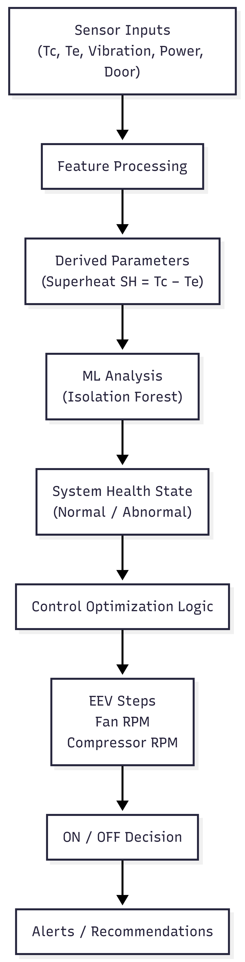
ML-Based Control Optimization Flow – Explanation
Sensor inputs capture real-time thermal, mechanical, and electrical conditions.
Feature processing prepares the data for reliable analysis.
Superheat is derived to represent refrigeration cycle performance.
Isolation Forest evaluates system behavior and detects anomalies.
The system health state is classified as normal or abnormal.
Control logic computes optimal EEV steps, fan RPM, and compressor RPM.
ON/OFF decisions ensure safe operation.
Alerts and recommendations support timely corrective action.

Slide 13
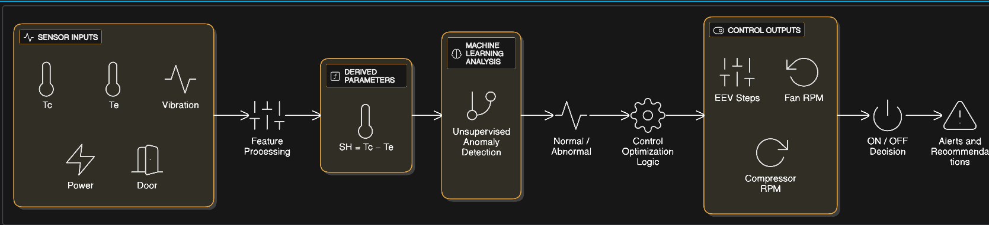

Slide 14

Machine Learning and Control Logic
ML Model Used
Isolation Forest (Unsupervised Learning)
Control Logic Role
Why Isolation Forest
ML output provides context, not direct commands
Control logic computes actuator values
No labeled fault data is required
Prevents overload, instability, and component damage
Learns normal freezer operating behavior automatically
Detects deviations at an early stage
Key line: "ML informs control; control decides action."
ML Output
System state: Normal or Abnormal
Severity of deviation from normal behavior

Slide 15
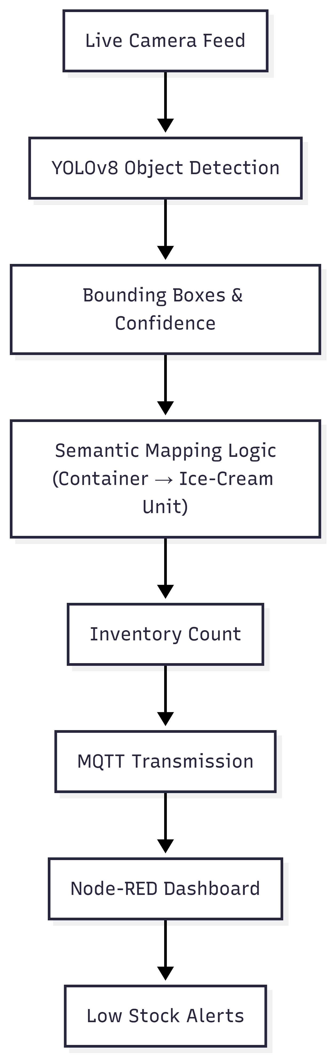

Phase 4: YOLO-Based Inventory
Vision-Based Inventory Monitoring using YOLO
Objective
Automate inventory monitoring inside the freezer
Eliminate manual inspection
Enable real-time stock awareness
ML Model Used
YOLOv8 (Real-Time Object Detection)
Key idea: "Vision replaces manual inventory checking."

Slide 16
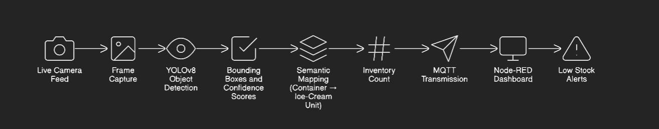
YOLO Logic and Design Justification
YOLO detects objects in real time, and logical mapping converts detections into inventory units.
Camera continuously captures freezer images. YOLO detects objects in real time. Logical mapping converts detections into inventory units. Inventory count is integrated into the IoT system.
Important Design Choice
01
02
03
Pretrained YOLO model is used
Ice-cream class not present in default dataset
Container-like objects mapped as ice-cream units

Slide 17
